Slide 1
Cognition

Slide 4
Concept

Slide 5
Boat

Slide 6
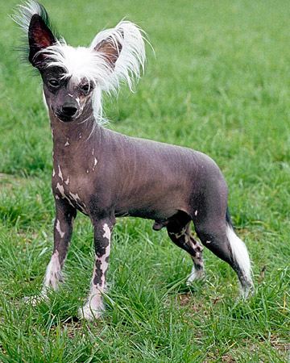
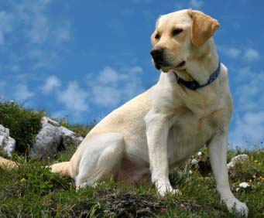
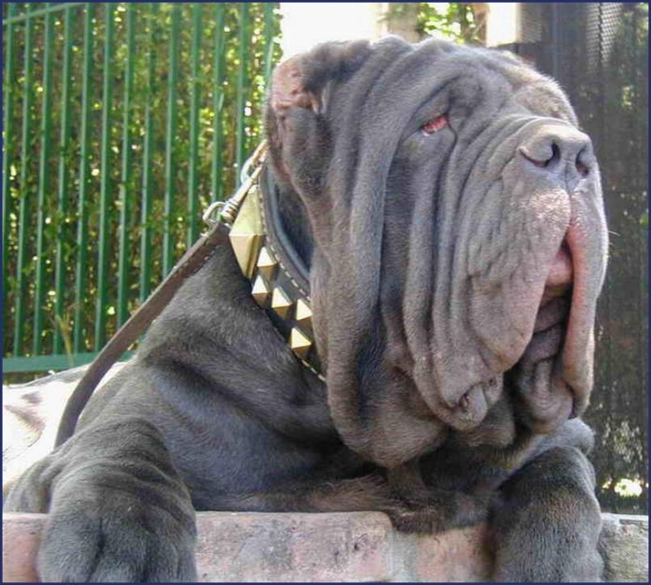
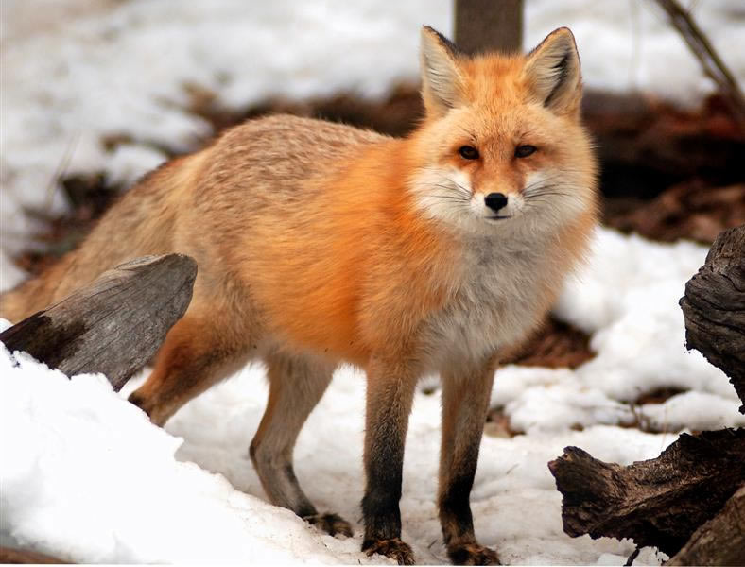
Prototype

Slide 7
Categorization influences our memory
Corneille and colleagues - 2004

Slide 8
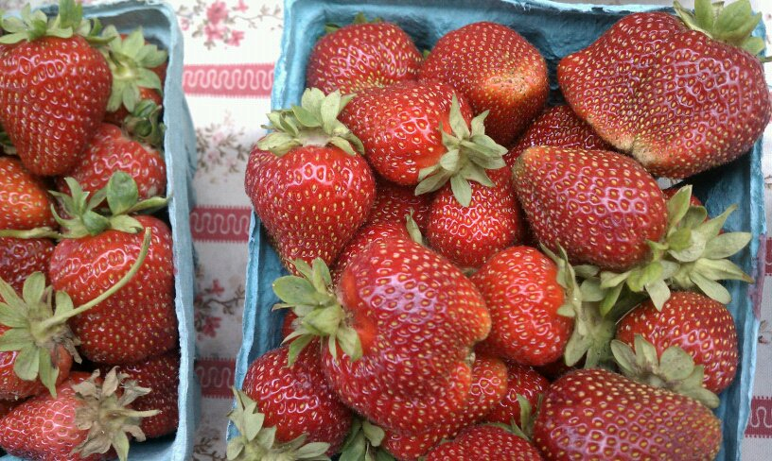
The further away from the prototype the less likely we are to recognize it quickly as belonging to that category.

Slide 9
Overconfidence Phenomenon
As humans, we tend to overestimate the accuracy of our current knowledge.

Slide 10
Algorithms vs. Heuristics
How much will my monthly bills cost me?
29.98
147.72
63.99
27.81
15.79
+299.93
Algorithm –adding
Heuristic – rounding

Slide 11
Algorithms vs. Heuristics How much will my monthly bills cost me?
Algorithm –adding
Heuristic – rounding
29.98
147.72
63.99
27.81
15.79
+299.93
585.22
30
150
60
30
20
+ 300
590

Slide 12
Decision Making
Heuristics help us act quickly but can bring us to problematic conclusions
Representative heuristic – judging the likelihood of a thing by its identification with a prototype (judging a book by its cover!)
Availability heuristic – making a judgment based on analysis of available information (what is in front of you or what comes to mind)
If an event is vivid in our mind we might assume it happens more often
ex – the bad news effect, Jaws, plane crashes, terrorism

Slide 13
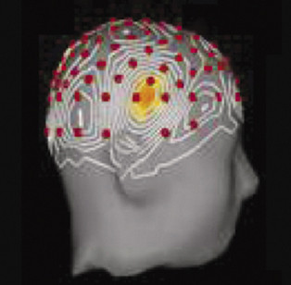
Insight
AHA!!!

Slide 14
Creativity
Creativity vs. intelligence
5 components – Sternberg and Lubart 1991
Expertise
An example of how the “new math” tries to build expertise
Imaginative thinking skills
Venturesome personality
Intrinsic motivation
Creative environment

Slide 15
Obstacles to Problem Solving
1. Belief Preservation Phenomenon – we cling to beliefs despite evidence to the contrary
2. Fixation
Mental set
Functional fixedness
https://www.youtube.com/watch?v=1cYzkyXp0jg
https://www.youtube.com/watch?v=egWvQuT5TCU
Overconfidence bias– we overestimate the accuracy of our knowledge regularly
Confirmation bias – ex Iraq

Slide 16
Intuition
Immediate effortless feeling or thought as opposed to explicit, conscious reasoning
Quick and often adaptive reactions to situations
“intuition is recognition” / “analysis frozen into habit”

Slide 17
Framing – 1
Framing -2

Slide 18
Framing
The context in which an issue is posed can significantly affect decisions and judgments
“$500 cash back!”
“JOB CREATOR” VS “1%” OR “WEALTHY”
“ROBBER BARRON” VS “CAPTAIN OF INDUSTRY”
Pro-abortion vs. pro-choice
Right-to-life vs. anti-choice
Global Warming vs Climate Change
Home-maker vs. housewife / stay-at-home-dad / vs. domestic engineer

Slide 20
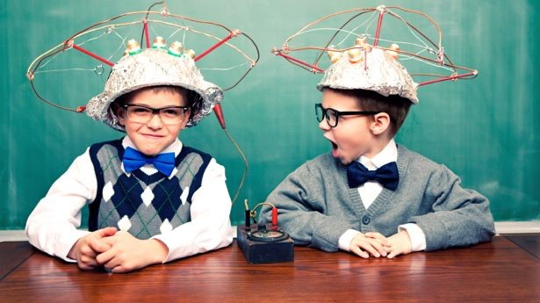

Slide 21
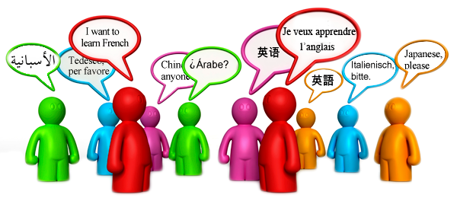
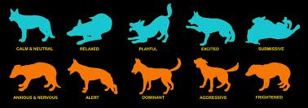
Language

Slide 22
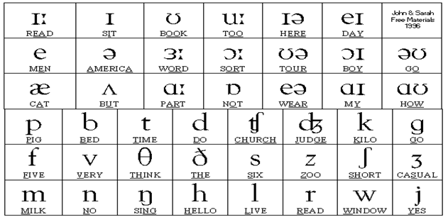
Structure of Language
Phonemes: individual units of sound in a language

Slide 23
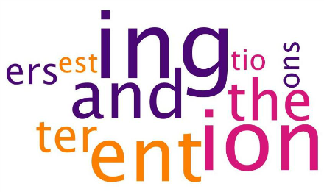
Morphemes
A segment of language that carries meaning and cannot be further divided

Slide 24
How many Morphemes?
Free – units that have meaning and can stand by themselves
Bound – units that create meaning but MUST be attached
How many morphemes? Divide them up!
Desire
Cats
Dishonorable
Recycling
Reliability

Slide 25
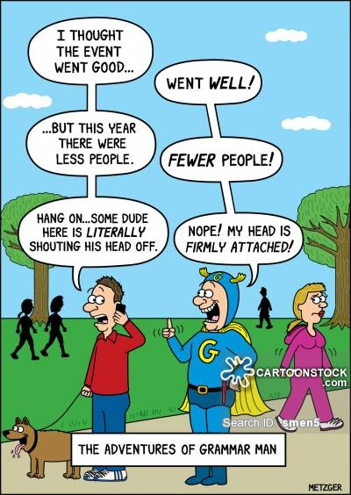
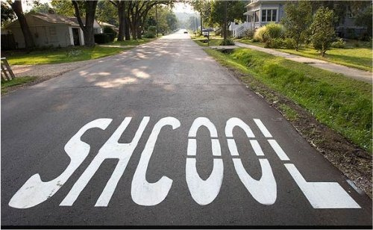
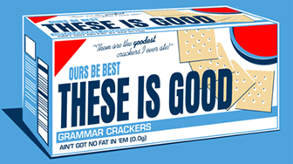
Grammar
A system of rules in a language that enables us to communicate with and understand others.
Grammar
Semantics
Syntax

Slide 26
Grammar in spoken language vs ASL
Language development for deaf children
“…children with strong language skills consistently outperform their peers on tests of intelligence and other measures of success. All this is true regardless of which language a child learns first, it can be English or another spoken language, or it can be sign language, and the research tells us the results will be the same. The earlier a child learns his first language, the greater his success will be in acquiring language skills and meeting other important developmental goals. Sign language provides the earliest possible mode through which children can learn expressive language skills. Use of sign language with young children, of any hearing status, is known to promote early communication. The reason for this is that children begin to learn language long before they are physically capable of reproducing speech.”
Hearing Child / Deaf Parents – “no problem!”

Slide 27
Semantics
Let’s eat, Grandma!
Let’s eat Grandma!

Slide 28
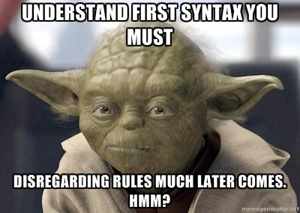
Syntax

Slide 29
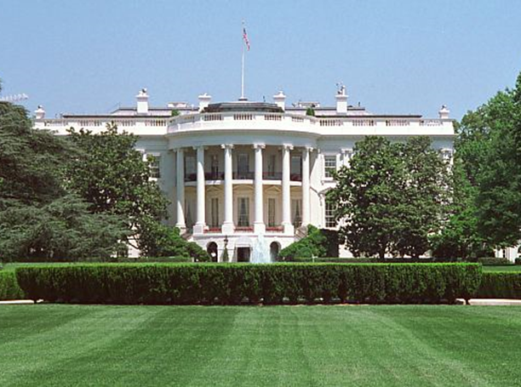
Grammar
Semantics: Set of rules by which we derive meaning from morphemes, words, and sentences. For example: Semantic rule tells us that adding –ed to the word laugh means that it happened in the past.
Syntax: The rules for combining words into grammatically sensible sentences. For example: In English syntactical rule is that adjectives come before nouns; white house. In Spanish it is reversed; casa blanca.
Notes:
Rules to derive meaning

Slide 30
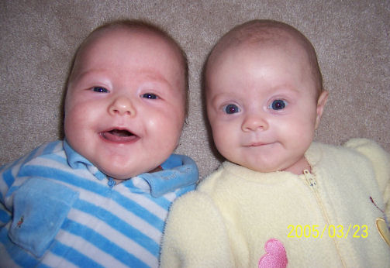
When do we learn?
4 months – comprehend speech (receptive)
6 months Babbling (productive)

Slide 31
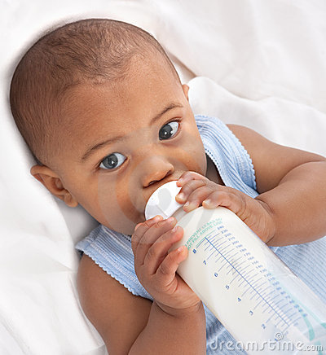
7 months
Segments sounds into separate words (receptive)

Slide 32
10 months
Sounds of the language of the household appear (productive)

Slide 33
Language
We are all born to recognize speech sounds from all the world’s languages
Percentage able
to discriminate
Hindi t’s
100
90
80
70
60
50
40
30
20
10
0
Hindi-
speaking
adults
6-8
months
8-10
months
10-12
months
English-
speaking
adults
Infants from English-speaking homes

Slide 34
12 – 18 months
12 month – 1 word stage (noun OR verb)
18 month 2 word stage (verb & noun)

Slide 35
2 word stage
“Telegraphic speech”
Cookie now!
Mommy ball!
Big horsey!
Like a telegraph
Overview of the speech milestones

Slide 36
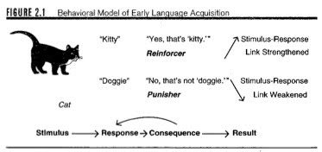
Learning language
B.F. Skinner – association, imitation & reinforcement
Parentese
Noam Chomsky: Inborn universal grammar
Wired for language
We readily can learn any language we experience because all have the same universal grammar
Nouns, verbs, subjects, objects, questions, descriptive words, limited set of phonemes, pronouns, basic category of 5 colors
Language particulars
Tense, rules of sequence and meaning (rules of grammar), types of vocalization, nasal stops
Genie Wiley

Slide 37
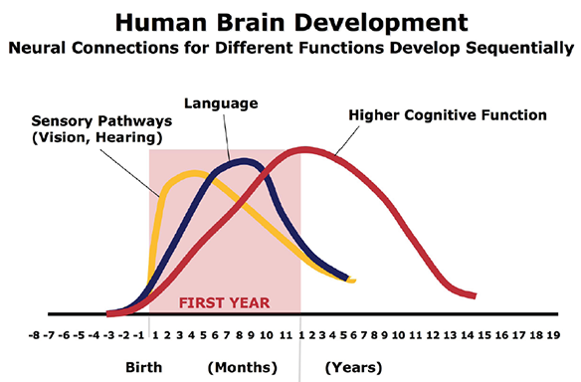
Critical Period
- a specific time during which an organism has to experience stimuli in order to progress through developmental stages properly for a particular skill or ability

Slide 38
What makes language change or grow?
Can language influence the way we think?

Slide 39
Sapir –Whorf Hypothesis
Benjamin Lee Whorf 1956: linguistic determinism
Different languages present us with different realities
Language shapes ideas and influences our thinking (even if it doesn’t determine our thinking)
Modern research on Language and Thinking

Slide 40
Navigation and Pormpuraawans In Pormpuraaw, an Australian Aboriginal community, you wouldn’t refer to an object as on your “left” or “right,” but rather as “northeast” or “southwest,” ….“speakers of such languages are remarkably good at staying oriented and keeping track of where they are, even in unfamiliar landscapes.” On a research trip to Australia, Lena Boroditsky and her colleague found that Pormpuraawans, who speak Kuuk Thaayorre, not only knew instinctively in which direction they were facing, but also always arranged pictures in a temporal progression from east to west. .
Blame and English Speakers English, we’ll often say that someone broke a vase even if it was an accident, but Spanish and Japanese speakers tend to say that the vase broke itself. Boroditsky describes a study by her student Caitlin Fausey in which English speakers were much more likely to remember who accidentally popped balloons, broke eggs, or spilled drinks in a video than Spanish or Japanese speakers. (Guilt alert!) Not only that, Boroditsky argues, but there’s a correlation between a focus on agents in English and our criminal-justice bent toward punishing transgressors rather than restituting victims. .
Color among Zuñi and Russian Speakers Our ability to distinguish between colors follows the terms in which we describe them, as Keith Chen notes in the academic paper in which he presents his research (PDF). A 1954 study found that Zuñi speakers, who don’t differentiate between orange and yellow, have trouble telling them apart. Russian speakers, on the other hand, have separate words for light blue (goluboy) and dark blue (siniy). According to a 2007 study, they’re better than English speakers at picking out blues close to the goluboy/siniy threshold. .
Gender in Finnish and Hebrew In Hebrew, gender markers are all over the place, whereas Finnish doesn’t mark gender at all, Boroditsky writes in Scientific American (PDF). A study done in the 1980s found that, yup, thought follows suit: kids who spoke Hebrew knew their own genders a year earlier than those who grew up speaking Finnish. (Speakers of English, in which gender referents fall in the middle, were in between on that timeline, too.)

Slide 41
So what is Language?
Do animals have it?
Can apes really learn human language?
The history of ape language studies.

