Slide 1

NYS Right-to-Know (RTK) Law
Your Rights to Information About Hazardous Chemicals Used in your Place of Work
Notes:
The New York State Right-to-Know Law protects your rights to information about hazardous chemicals that are manufactured, stored, or used at your place of work.
If you work in a NYS public school, it is unlikely that chemical will be manufactured in your building. However, there are numerous products in your building, some of them very common, that contain hazardous chemicals.
You have a legal right to information about such products.

Slide 2

RTK Enforcement
NYS RTK law is enforced in public schools through the NYS Department of Labor, as part of the Public Employees Safety & Health (PESH) Act of 1980
Notes:
The New York State Department of Labor, Public Employees Safety & Health (PESH) division enforces the NYS Right-to-Know Law in places of public employment in NYS, including public schools.
PESH is essentially enforcing the requirements of the federal Occupational Safety & Health Administration’s (OSHA) Hazard Communication Standard. The Hazard Communication Standard ensures workers in places of private employment the same rights to information about hazardous chemicals as the NYS Right-to-Know Law.

Slide 3

WHAT IS REQUIRED OF YOUR EMPLOYER?
Employer must have a written HAZCOM Program
Employer must provide you with annual training & information about hazardous chemicals
Employer must maintain a hazardous materials inventory
Employer must maintain Material Safety Data Sheets (MSDS) for hazardous chemicals
HAZCOM plan can be found in the Facilities and Operations office
MSDS Sheets can be found in each building in the custodian’s office as well as in F&O.

Slide 4








The Globally Harmonized System For Hazardous Communication
EXPLOSIVE
FLAMMABLE
OXIDIZER
IRRITANT
HEALTH HAZARD
COMPRESSED
GAS
TOXIC
CORROSIVE

Slide 5
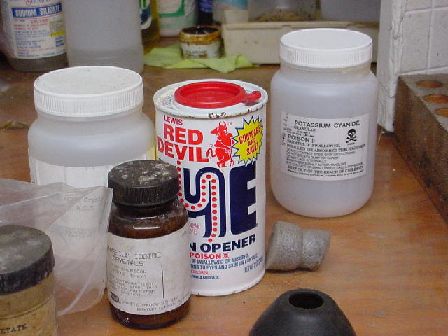
What hazardous chemicals might be found in a school building?
Laboratory chemicals & waste
Cleaning supplies
Office products
Construction & maintenance materials
Notes:
Many substances found in a school building contain hazardous materials. Numerous laboratory chemicals, for example, present health, fire, explosion, and reaction hazards. For example, laboratory grade hydrogen peroxide can, over time, become very unstable. Such a material presents a significant fire and explosion hazard.
However, common office products, like white out, rubber cement, and copier toner, contain hazardous chemicals. Read the product label and obtain an MSDS before using these products.
Many of the products used to maintain your school’s buildings and grounds may contain hazardous chemicals. These include cleaners, paints, adhesives, solvents, and pest control products. If you feel you are having a reaction to a product being used in your work environment, contact your Chemical Health & Safety Officer.

Slide 6
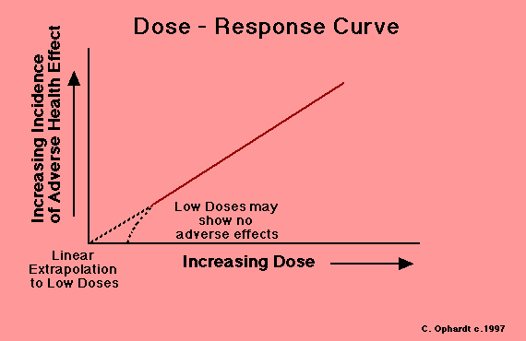
HAZARD vs. TOXICITY
TOXICITY - The ability of a substance to harm living cells, tissue, or tissue systems
HAZARD - The likelihood harm will occur under certain conditions (dose, susceptibility)
Notes:
Toxicity is the inherent capacity of a chemical substance to produce harm or injury to living tissue provided that a sufficient dose is delivered to the target organ or system.
Hazard is the probability that the sufficient dose will be delivered to the target organ or system. If a toxic chemical cannot reach its target organ or system it presents no hazard.
As can be seen in the diagram, response ... physical harm or injury ... generally increases with an increased dose. This pattern is harder to predict at very low doses.
Hazard is highly dependent upon the route of entry of a hazardous chemical into the body.

Slide 7

Routes of Exposure
Inhalation
Skin Contact
Ingestion

Slide 8
HEALTH EFFECTS FROM
CHEMICAL EXPOSURE
ACUTE
Generally occur shortly after exposure
Usually resolve themselves
  Headache
  Nausea/Vomiting
  CNS disturbances
  Dead
CHRONIC
Long latency period
Generally result from long-term exposure
  Cancer
  Heart disease
  Pulmonary disorders
  Kidney disease

Slide 9
CHEMICAL HAZARDS 1
Carcinogens
Substances capable of producing cancer (abnormal cell growth). May be genotoxic or epigenetic.
  Asbestos (Group 1)
  Benzene (Group 1)
  Benzo(a)pyrene (Group 2A)
  Formaldehyde (Group 1)
Notes:
Chemical carcinogens are substances capable of producing abnormal cell growth. The manner in which this occurs in not always known. The International Agency for Research on Cancer (IARC) lists carcinogens as:
Group 1: Human Carcinogens
Group 2A & 2B: Probable Human Carcinogens
Group 3: Not Classified
Group 4: Probably not Human Carcinogens
Asbestos, benzene, and formaldehyde ... All relatively common in public buildings are classified as Group 1 carcinogens by the IARC. Benzo(a)pyrene, found in cigarette smoke and on a grilled steak, is considered a probable human carcinogen by the IARC.

Slide 10
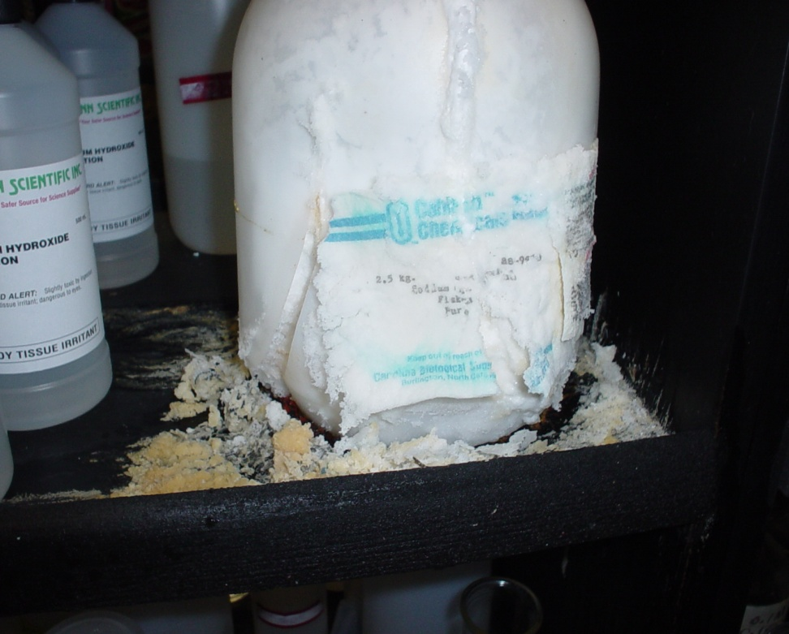
CHEMICAL HAZARDS 2
Corrosives/Caustics
Substances capable of causing irreversible alteration to living tissue. Very low or high pH.
  Hydrochloric Acid
  Ammonium Hydroxide
  Sulfuric Acid
  Sodium Hydroxide
Notes:
These substances, either in solid or liquid form, can cause damage to living tissue that is irreversible. By and large these are strong acids or alkalis that have either very low or very high pHs.
Sulfuric acid, found in lead acid batteries, and sodium hydroxide, found in may drain openers, are common examples of a corrosive and caustic, respectively.
If a corrosive or caustic substances must be mixed with water, always add them to the water, and do so slowly.

Slide 11
CHEMICAL HAZARDS 3
Irritants
Substances capable of causing reversible inflammation of living tissue. Generally affect skin and upper respiratory tract.
  Ammonia
  Pepper Spray
  Volatile Organic Compounds
Notes:
Irritants are chemical substances that cause a usually reversible inflammation of the skin, mucous membranes, or respiratory tract. Such inflammatory reactions can range from mild irritation to life-threatening in certain individuals.
Common irritants include ammonia and various volatile organic contaminants. These can be found in many cleaners, paints, and adhesives.
Avoiding contact with these materials is the key to avoiding inflammatory reactions.

Slide 12
CHEMICAL HAZARDS 4 Sensitizers
Substances capable of causing an enhanced immune system response. Reactions become more serious over time.
  Formaldehyde
  Isocyanates
  Metals
  Vinyl Chloride
Notes:
Sensitizers cause an immune system response in susceptible individuals. Such responses usually occur following repeated exposures, and can range from hives to anaphylactic shock. Formaldehyde and certain metal fumes are common occupational sensitizers.
Due to increased use in biohazard barriers, many people have developed a sensitivity to natural rubber latex (NRL). Such individuals should avoid exposure to gloves, medical devices, and other items that contain NRL. Synthetic rubbers like nitrile and neoprene are an appropriate substitute.

Slide 13

CHEMICAL HAZARDS 5
Teratogens
Substances capable of perinatal aberrations in an exposed embryo or fetus (i.e. birth defects).
  Ethanol (beverage alcohol)
  Lead
  Thalidomide
Notes:
These substances have the ability to produce abnormalities in a developing embryo or fetus. Because there is no barrier to prevent transmission of lead from mother to fetus, occupational exposure to lead is a concern for women who are pregnant or are considering pregnancy. Fetal exposure to lead may result in impaired neurological function at levels that are not toxic to the mother.
The most common teratogen in the United States is ethanol - beverage alcohol. The chronic consumption of alcohol during pregnancy can result in Fetal Alcohol Syndrome (FAS). FAS is characterized by developmental disabilities, and skeletal & facial deformities
Thalidomide, given to women in the 1960s to combat morning sickness, affected limb budding. This resulted in children being born with malformed, or missing, arms and legs if there mother took this drug during early pregnancy.

Slide 14

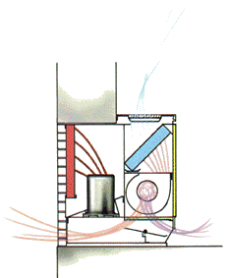
Controlling Chemical Hazards in the Workplace
Engineering Controls
  Ventilation – Dilution and local
Administrative Controls
  Training & Education
Personal Protective Equipment (PPE)
  Gloves, respirators, clothing
Notes:
There are three categories of controls that environmental health & safety professionals utilize to control workplace hazards, including chemical hazards, and protect employee safety.
Engineering Controls are the first controls employed to reduce chemical hazards in the workplace. Engineering controls reduce the hazard at it’s source. Engineering controls include ventilation, chemical substitution, and enclosures.
Administrative Controls are employed when engineering controls are infeasible or insufficient. Administrative controls include shift or assignment rotation to reduce an employee’s exposure. Other administrative controls include training and environmental monitoring.
Personal protective equipment (PPE) is the last line of defense against hazardous chemicals. PPE does nothing to reduce the hazard in the work environment, but rather protects the wearer from exposure. PPE must be appropriate for the chemical hazards and must be used properly.

Slide 15
IF YOU HAVE ANY QUESTIONS ABOUT THIS PRESENTATION
Please contact Michael O’Rourke
Ulster BOCES Risk Management
(845)255-1400
morourke@mhric.org

Slide 16
Reading that MSDS/SDS sheet
Required Information on a MSDS/SDS:
(A) The Chemical Name
(B) Any Common Names
(C) The CAS Number of the "Hazardous Substance“
(D) The Potential for Explosion
(F) The Potential for Reactivity
(G) Acute and Chronic Health Effects
(H) Potential Routes of Exposure
(I) Symptoms of Overexposure
(J) Proper Precautions
(K) Handling Practices
(L) Necessary Personal Protective Equipment
(M) Other Safety Precautions in the Use of or Exposure to the "Hazardous Substance“
(N) Emergency Procedures for Spills
(O) Emergency Procedures for Fire
(P) Disposal Procedures
(Q) First Aid Procedures Risks Posed by the "Hazardous Substance"
(R) A Description in Lay Terms of the Specific Potential Health Hazard
(S) The Month and Year the Information was Compiled
(T) Name and Address of the Manufactures Responsible for Preparing the Information
DIRECTIONS FOR READING MSDS SHEETS ARE AVAILABLE ON OUR
HEALTH/NURSING WEB PAGE
(this information courtesy of )

Slide 17
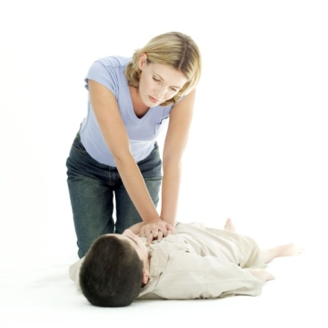

SAFETY ITEMS YOU NEED TO KNOW
CPR/AED- Anyone who spends time with students before/after school hours needs to be trained…
Weather Safety Tuck
Our students Pre K-8 know it as
“Turtle-ing up”, 9-12 know it as the weather safety tuck. Take students into the hallways away from windows and tuck up….

Slide 18
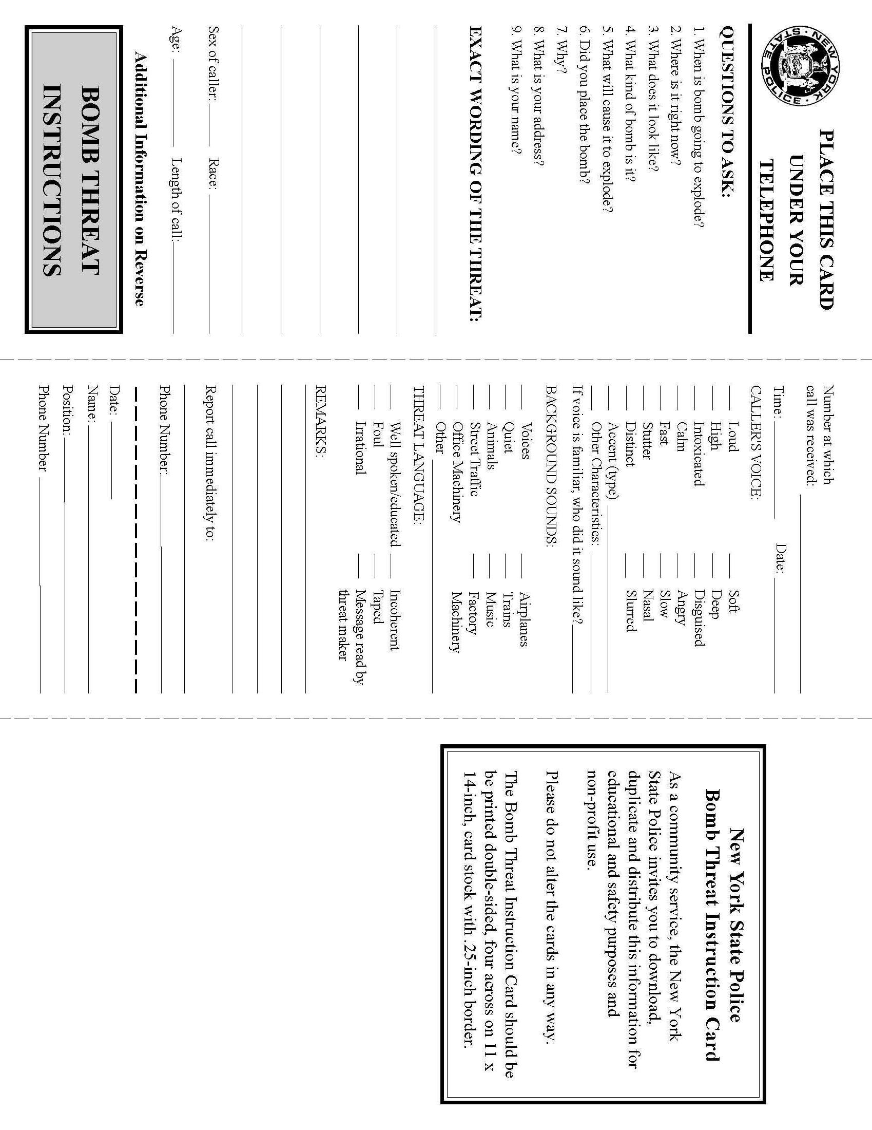
REVISED EMERGENCY RESPONSE CODES
Lockdown
stop all activity
Gather students from hallway into classroom
Lock exterior/classroom/office door(s) immediately.
If you are the designated individual – disable proximity card readers
Turn lights out if available while locking door; otherwise leave them as they are.
Do not allow anyone to enter or leave the room/office (this includes faculty and staff).
Move to an interior corner(s) of the room
  Leave window blinds as they are, do not cover windows unless you have a window to a courtyard. Close courtyard blinds.
Take attendance, attend to injuries as necessary
Keep quiet- do not answer door, classroom phone or pa, do not communicate through door
Retrieve your cell phone if it does not cause undue exposure. Silence it to vibrate
Instruct students to silence their cell phones
Instruct students that texting is not allowed during emergency events
Do not respond for fire alarm unless smoke/flame is obvious
Pe/recess and classes outside report to their pre-assigned area out of sight as per building plans
Do not open door or return to building until released by police
Lockout
All students are to return to the building immediately
All exterior building doors are to be locked including the single point of entry
If you are the designated individual – disable proximity card readers
Allow no one to enter the building
-only emergency personnel will be allowed to enter after being screened
-Entry by emergency personnel will be through the single point of entry only
No student is allowed to leave the building
Classes will continue as scheduled but with no outside activities
Be prepared to change modes (I.E may go to lockdown, evacuation etc.)
You may answer your classroom phone and/or follow pa directions
IT IS STRONGLY RECOMMEND THAT NO ADULT LEAVE THE BUILDING, LEAVING WILL BE DONE AT YOUR OWN RISK ( as per dialogue with legal counsel 4/11/13)
Evacuation
Perform a cursory check of your area for any unusual packages or items. Report unusual items to authorities
2) building level response team checks shelter-in-house, or evacuation outside areas as directed.
3) follow directions for in-house sheltering or evacuation as per administration. Report to assigned area.
Check attendance and be prepared to report any unaccounted for students both before and after arriving at the prescribed destination.
Supervise your class. Do not let anyone leave or join your class.
Stand by for additional instructions from administrative officials.
When the "all clear" is given, resume activities as directed.
Shelter in place
Announcement will be – to shelter in place
1) scan the room for any unusual objects. Report unusual items to authorities
2) take attendance.
3) listen for instructions. Do not move from room until told to do so
4) supervise your students
5) when the "all clear" is given, resume activities as directed.
Medical emergency "…in room _____"
Emergency medical response team report to the designated room.
Bring aed
Follow pre arranged duties.
PLACE BY ALL PHONES
- SHOULD BE ONE ON YOUR CLASSROOM WALL BY THE FIRE EXIT SIGN
ONE WITH YOUR ATTENDANCE
ONE IN YOUR SUB FOLDER WITH ALL OTHER PERTINENT BUILDING SAFETY INFORMATION

Slide 19
911 AND YOU
If you see a situation which in your estimation warrants immediate attention by Police/Fire/Ambulance –
YOU MAY CALL 911 WITHOUT ASKING PERMISSION FROM YOUR SUPERVISOR.
Your second call must then be to your supervisor.

Slide 20
OVER THE COUNTER MEDICATIONS
Nurses are no longer able to provide you with even simple Over- the- Counter medications such as Tylenol, Advil etc. without written Physician’s orders. You need to keep medications of any type in a safe place out of reach of your students. The nurse can hold it for you if it is appropriately labeled and if you have written orders for O-T-C meds. Please make sure your Nurse has a copy of the Doctor’s orders.
Please plan accordingly.
To ask your nurse to bend on this is to compromise her license.

Slide 21

The 2016-2017 Annual Notice to Employees will be
e-mailed to all District employees who have District e-mail addresses. Receipt forms will be returned electronically as well. Please follow the directions in the e-mail to return the receipt.
A copy of the 2016-17 District Calendar will also be e-mailed to you.
Staff who do not have an e-mail address at this time will be receiving a copy during your meeting with your supervisor(s).

Slide 22
Occupational Safety & Health Administration (O.S.H.A)
Blood-borne Pathogens Training
Workplace Blood-borne pathogen standards enacted in 1992 were designed to eliminate or minimize exposure to Blood-borne pathogens
Notes:
In 1993 osha set specifications to help cut down exposure rates

Slide 23
Workplace Exposure Control
All workplaces must have a plan to eliminate or minimize exposure
  information
  training
  retraining if procedures change

Slide 24
Blood-borne Pathogens are
Microorganisms (Bacteria & Viruses) carried in the bloodstream and in other body fluids which can contain blood.
These microorganisms can cause disease(s)
Notes:
Germs carried in the blood stream are more likely to cause the most severe illnesses… such as “ click”

Slide 25
HIV & AIDS
        HIV (human immunodeficiency virus) is the weakening of the body’s immune system by one of many blood-borne pathogens.
        HIV causes AIDS (Acquired Immunodeficiency Syndrome)
AIDS IS FATAL
There are treatments
There are NO cures
So please pay attention not to become contaminated
at any blood and body fluid incident.
Notes:
HIV is one of a number of infectious blood borne pathogens

Slide 26
Hepatitis B (HBV)
HBV is a chronic infection which attacks the liver-
Contracted though blood-borne pathogens
Extremely infectious!!!!! (1:20 will get HBV)
Vaccine can prevent, anti-viral medications to fight chronic infection
Hepatitis B Vaccine- PREVENTION !!!!
Given in a series of 3 doses, over a period of 6 months
Check with your personal physician first
Will be provided by the District at no cost to the following staff members at high risk for exposure- (check with your supervisor to see If you qualify)
  Nurses, Health Staff, PE Teachers, Coaches
  Custodians, Cleaners, Maintenance workers
  Mechanical Arts Teachers,
  Teachers, Aides, Therapists of physically/developmentally disabled students
  CPR/AED trained staff members
  Playground monitors
Notes:
And if you thought HIV/AIDs was bad, this one is equally as nasty and… believe it or not this one is much easier to catch…..HBV is preventable this by a vaccine series… If you believe you fall into the categories listed at the bottom please see your supervisor
To determine whether you should be immunized…

Slide 27

FLU/other illnesses
THOUGH THE FLU VIRUS IS AIRBORNE IN DROPLET FORM PROTECTING YOURSELF FROM THE FLU & OTHER ILLNESSES IS VERY SIMILAR TO PREVENTING HIV/AIDS & HEP B.
WASH YOUR HANDS OFTEN.
WHEN POSSIBLE KEEP A WINDOW OPEN
DO NOT PUT THAT PENCIL IN YOUR MOUTH
HAND CREAM, LIP BALM ET. AL. ALSO CARRY GERMS…
TRY NOT TO WEAR THESE TO WORK IF POSSIBLE
FOOD NEEDS TO BE IN CLOSED CONTAINERS
IF YOU GET SICK- STAY HOME !!!! UNTIL YOU ARE FEVER FREE FOR AT
LEAST 24 HOURS WITHOUT MEDICATION.

Slide 28
What is an Exposure
OSHA defines an exposure as:
“A specific, eye, mouth, other mucous membrane, non-intact skin, parenteral (piercing mucous membranes or the skin barrier through such events as needle-sticks, human bites, cuts, and abrasions) contact with blood (DRIED OR WET) or other potentially infectious materials that result from the performance or an employee’s duties.”
Notes:
Sorry… this is the official definition…

Slide 29
TRANSLATION …. An exposure is
DIRECT CONTACT WITH BLOOD OR OTHER POTENTIALLY INFECTIOUS MATERIALS (OPIMs) through an
  Open SKIN wound (contact)
  MUCOUS MEMBRANE(s) includes eyes and swallowing (ingestion/inhalation)
  PUNCTURE WOUND(s) (injection)
Notes:
And the translation (read this slide)

Slide 30
O.P.I.Ms.
(other potentially infectious materials)
Human body tissues, animal tissues
  living or dead
Blood/Body Fluid
  Wet- HBV up to 7 days
  Dry—up to 72 hours out of body
Cultures, Containers, Sharps, etc
Notes:
Think of it this way… if someone bleeds on it, and you touch it, or it sticks you, you can catch whatever that person has….
So pay attention to the things you pick up

Slide 31
Protecting yourself from exposure
If you are not trained, don’t touch, keep away, isolate/cover if necessary to keep from spreading.
Use Personal Protective Equipment (PPE)
For clean up use an approved solution
Follow workplace plan
  Copies in Nurses’ offices, F&O, Athletic Office
Get vaccinated if applicable

Slide 32
Personal Protection
Gloves, goggles, face shield, mask, aprons or jumpsuits (playground kits)
Cover all cuts, scrapes, sores
Keep work area clean & sanitized
Handle sharp objects by mechanical means
Do not handle any food, cigarettes, make-up including hand cream when around infectious fluids
Clean up body fluids, PPE and any potentially infectious materials and place in an appropriately labeled bag or container. If you are unsure what to do with the materials ask your supervisor for final determination.
Wash hands and any exposed area immediately after providing care, cleaning or the removal of PPE.

Slide 33
If You Are Contaminated
Stop - whatever you are doing as soon as possible
Wash - the exposed area with soap and water
  attempt to save any contaminated materials for testing
Report - the incident to your immediate supervisor
Get post exposure vaccinated

Slide 34
SUMMARY
AN OUNCE OF PREVENTION IS WORTH…….
IF YOU’RE NOT TRAINED, DON’T TOUCH
IF YOU DON’T KNOW, ASK...

Slide 35
NEW PALTZ CSD
Right to Know Training & Blood Bourne Pathogen Training
I HAVE RECEIVED THE
Right to Know Training
PLEASE SIGN AND RETURN THIS FORM ON THE DATE OF RECEIPT
NAME (Please Print)
___________________________________________
DATE ________________________________
SIGNATURE_____________________________________

