Slide 1
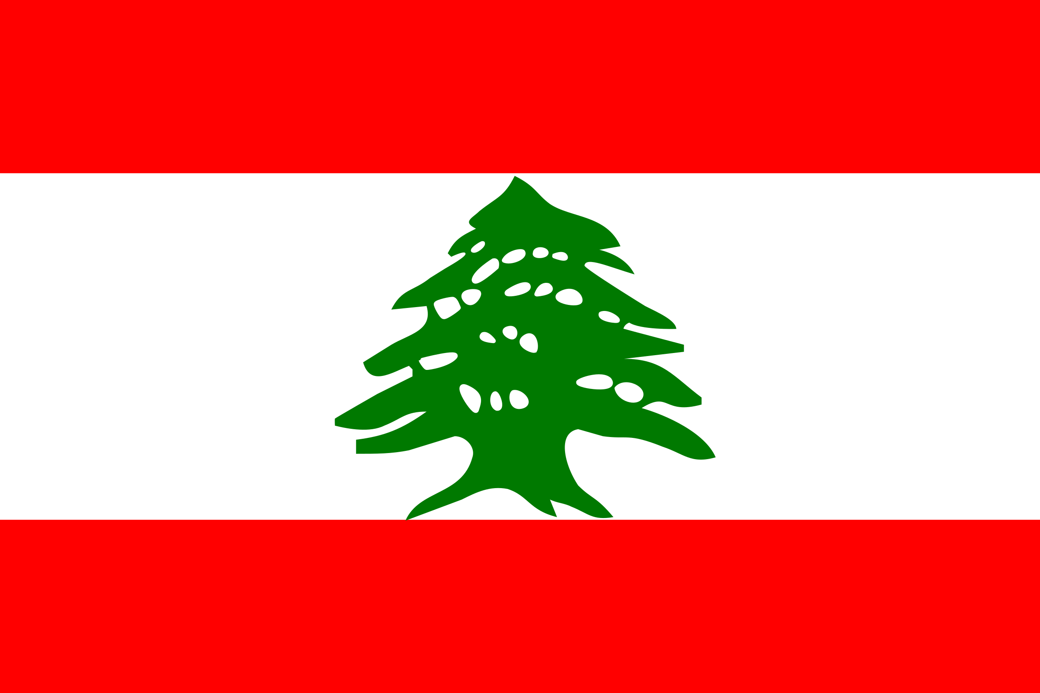
Lebanon
Ann

Slide 2
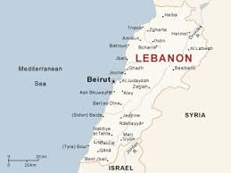
The Geography
Climate:
Mediterranean; mild to cool, wet winters with hot, dry summers; the Lebanon Mountains experience heavy winter snows
Capital: Beirut
Location: Middle East
Neighboring countries: Syria and Israel
Bodies of water: Mediterranean Sea

Slide 3
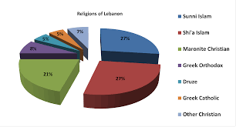
The People
Nationality: Lebanese
Ethnic Groups: Arab 95%, Armenian 4%, other 1%
Languages: Arabic (official), French, English, Armenian
Religions: Muslims 54%, Christian 40.5%, Druze 5.6%, Jews, Baha’is, Buddhists, Hindus, and Mormons
Population: 6,184,701 (July 2015 est.)
Population Growth Rate 0.86% (2015 est.)

Slide 4
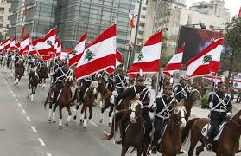
Government
Type: Republic
Prime Minister: Tammam Salam
Independence: November 22, 1943 form the League of Nations mandate under French administration
National Symbol: cedar tree
National Colors: red, white, and green

Slide 5
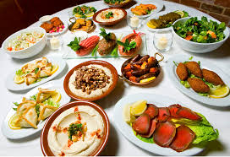
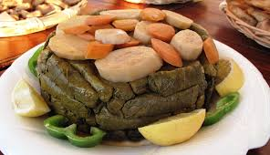
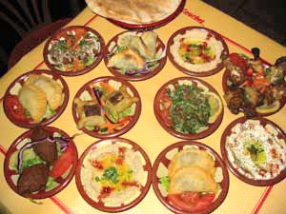
Traditional Lebanese Cuisines
Lebanese Cuisine usually include: Olive oil, herbs, garlic and lemon are typical flavors found in the Lebanese diet
Which also includes an abundance of starch, whole grain, fruits, vegetables, fresh fish, and sea food

Slide 6
Agriculture
Products:
Citrus
Grapes
Tomatoes
Apples
Vegetables
Potatoes
Olives
Tobacco
Industries:
Banking
Tourism
Food Processing
Wine
Jewelry
Cement
Textiles
Oil Refining
Metal Fabricating
Labor Force: 1,628 Million

Slide 7
Imports
Commodities
Petroleum Products
Cars
medicinal Products
Clothing
Partners
China
Italy
US
France
Germany
Russia
Greece
Meat and live animals
Consumer goods
Paper
Textile fabrics
Tabaco
Chemicals

Slide 8
Exports
Commodifies
Jewelry
Base Metals
Chemicals
Consumer Goods
Fruit and Vegetables
Tobacco
Construction minerals
Electric power machinery
Textile fibers
Paper
Partners
Saudi Arabia
UAE
Syria
Iraq
South Africa
Switzerland

